Slide 1
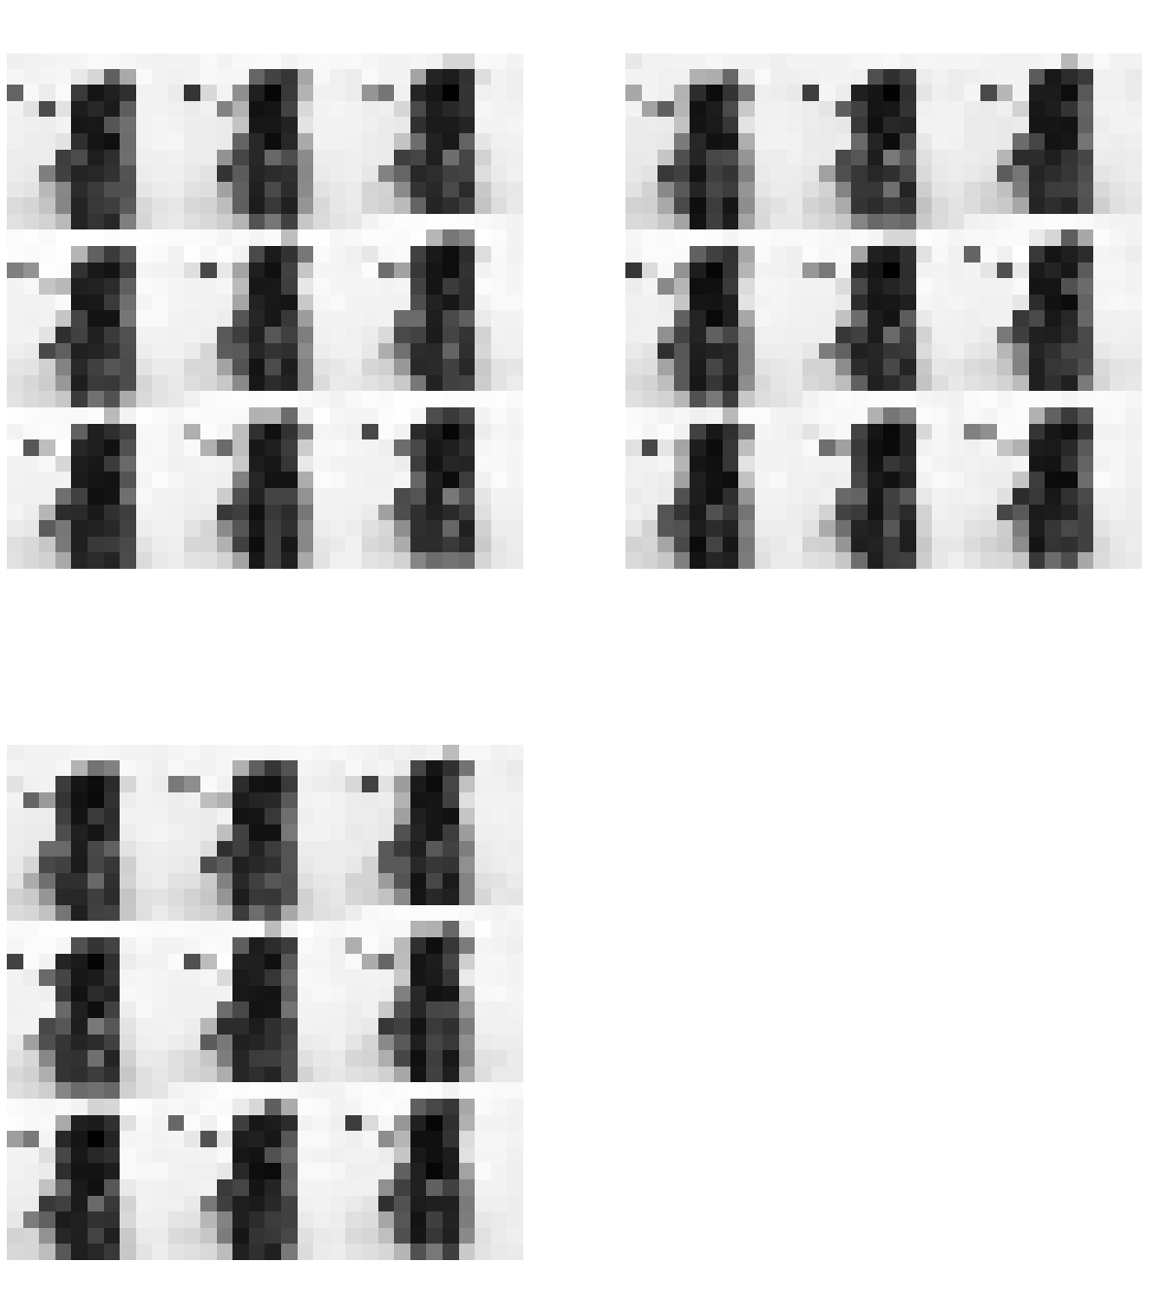
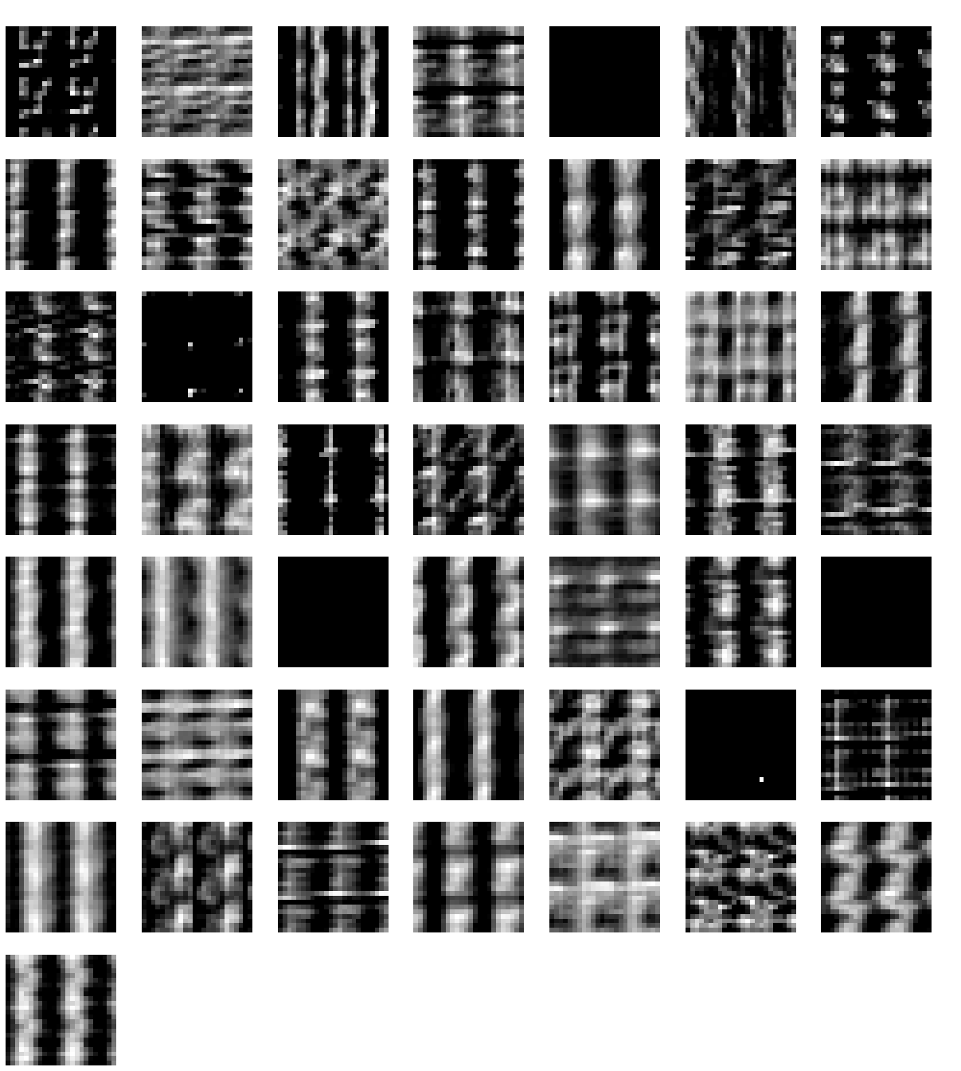
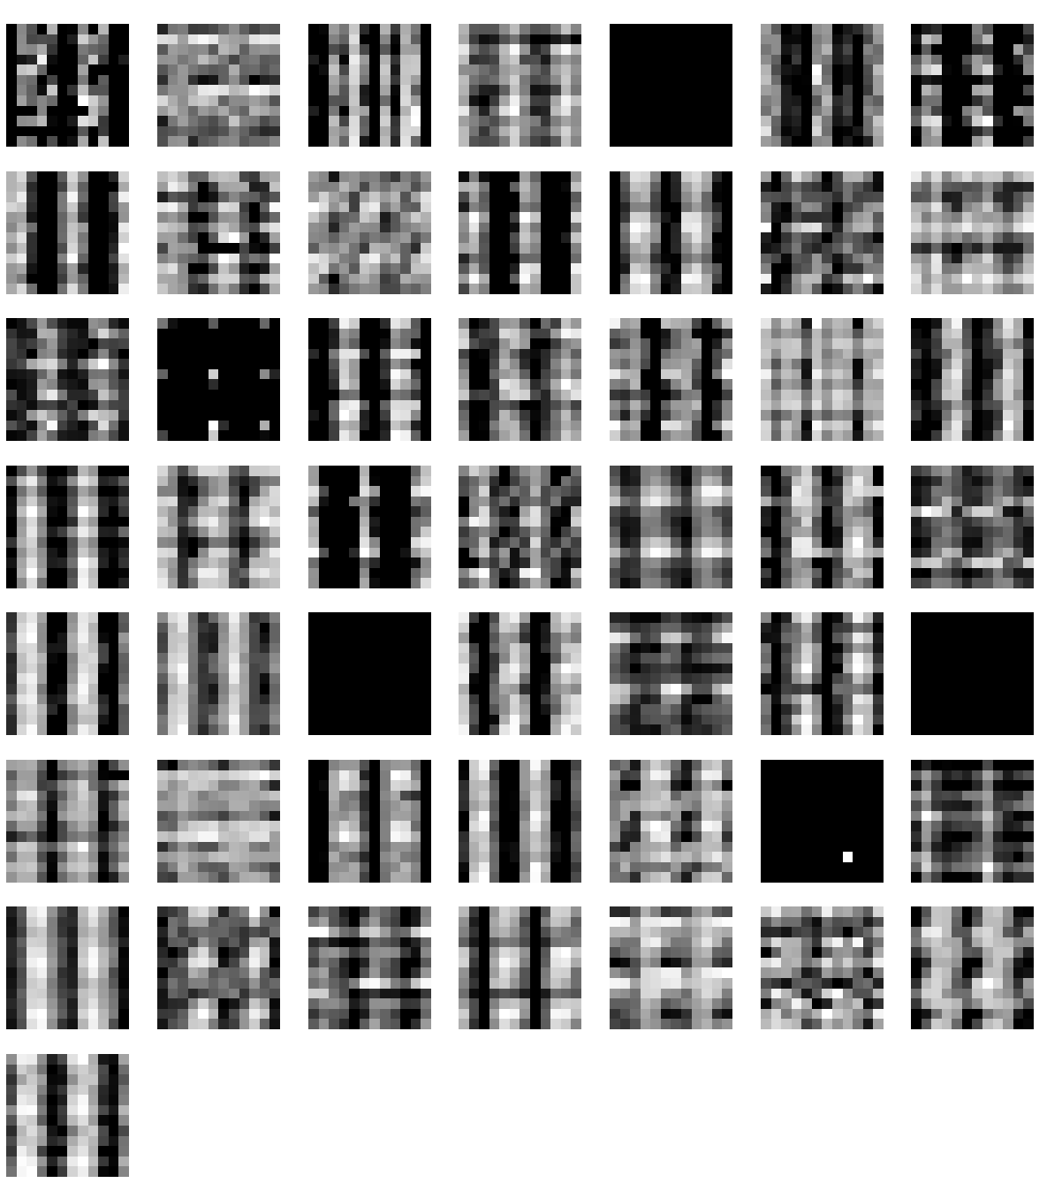
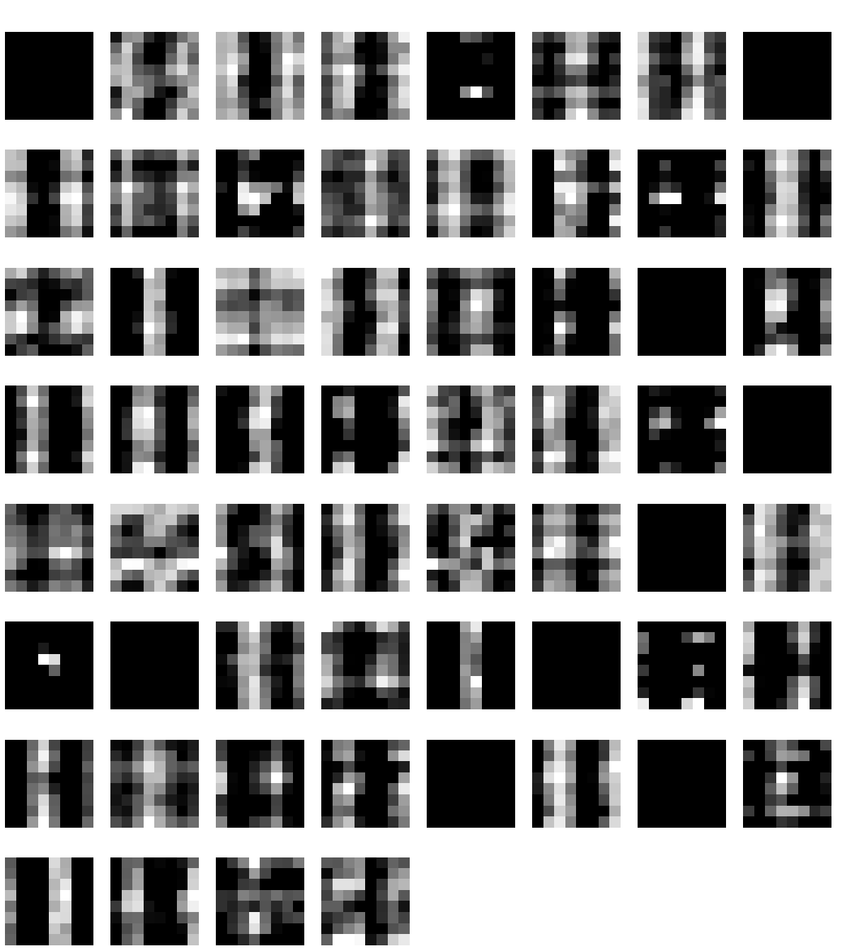
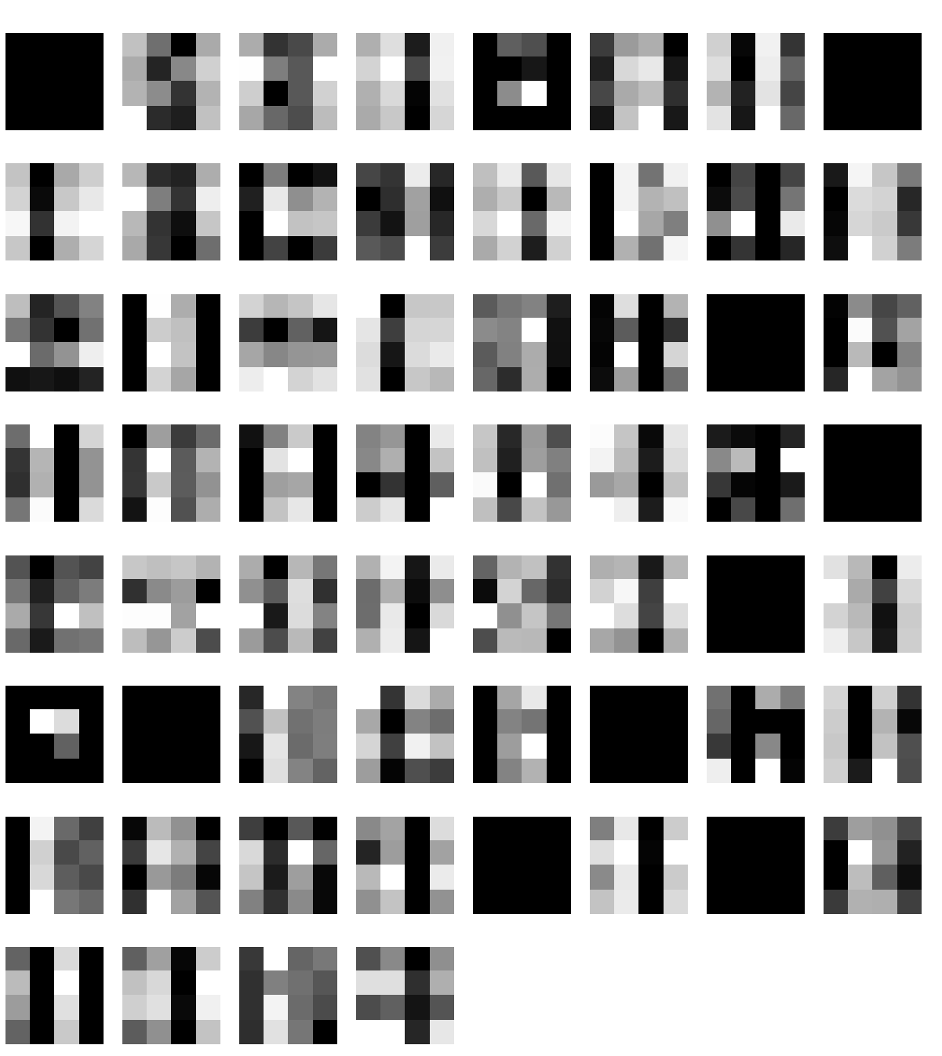
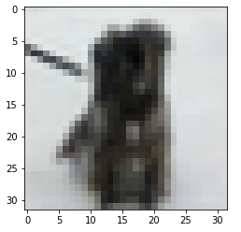
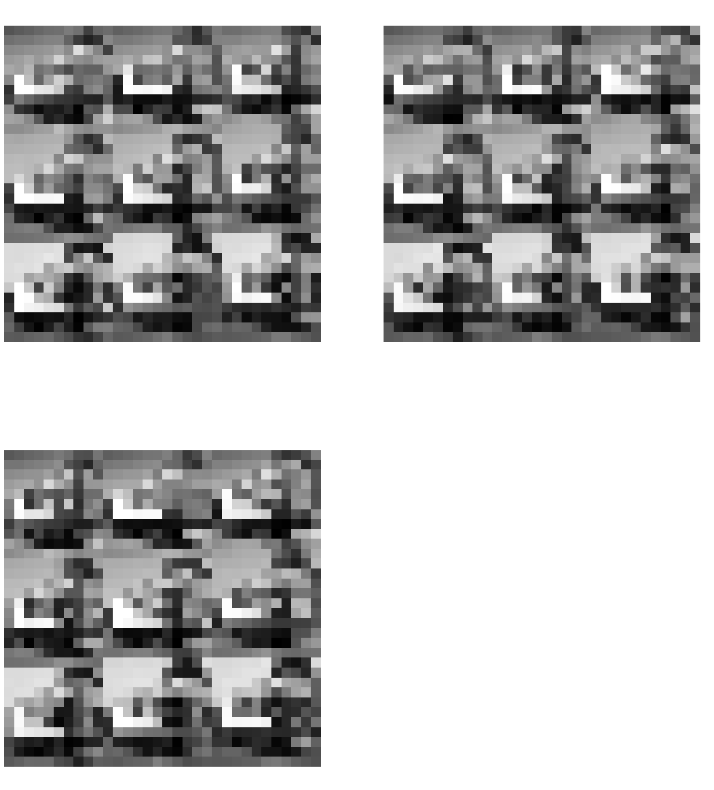
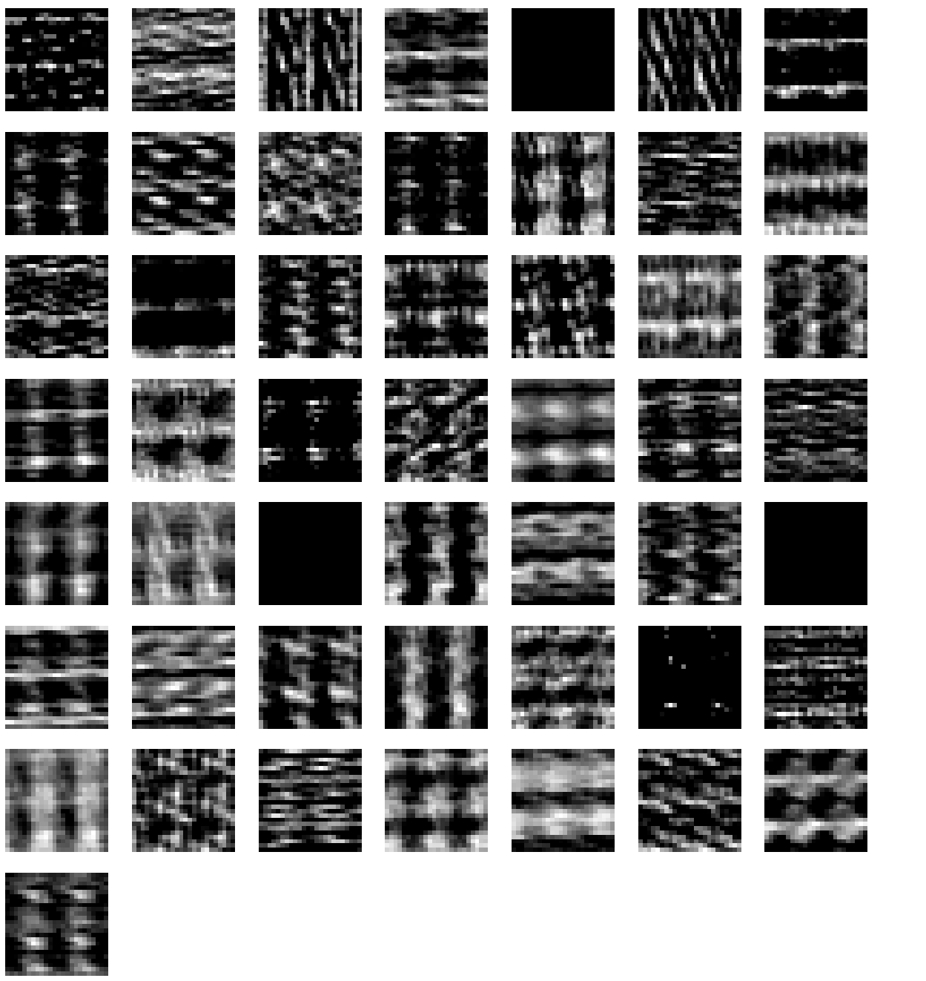
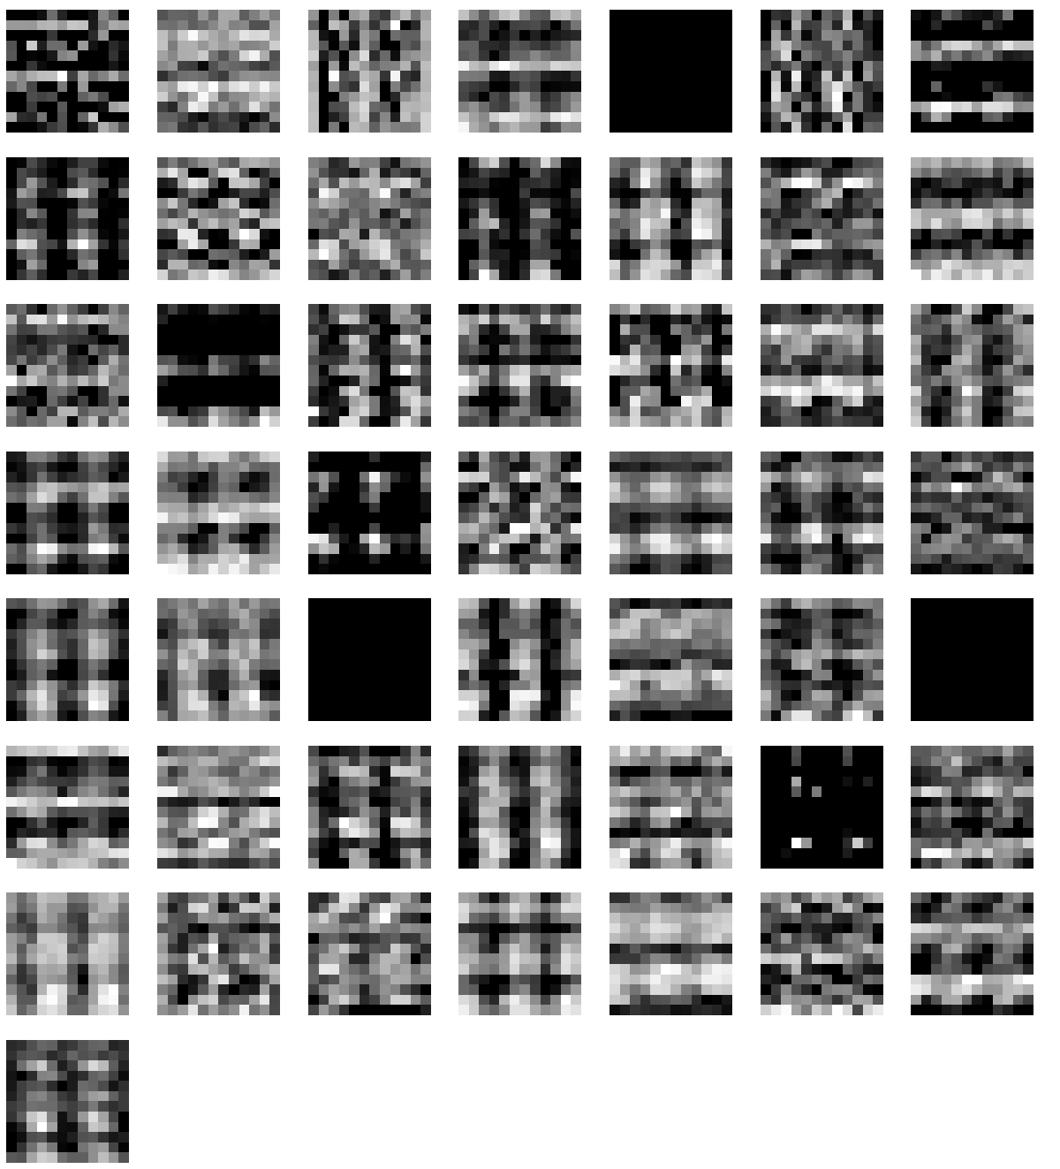
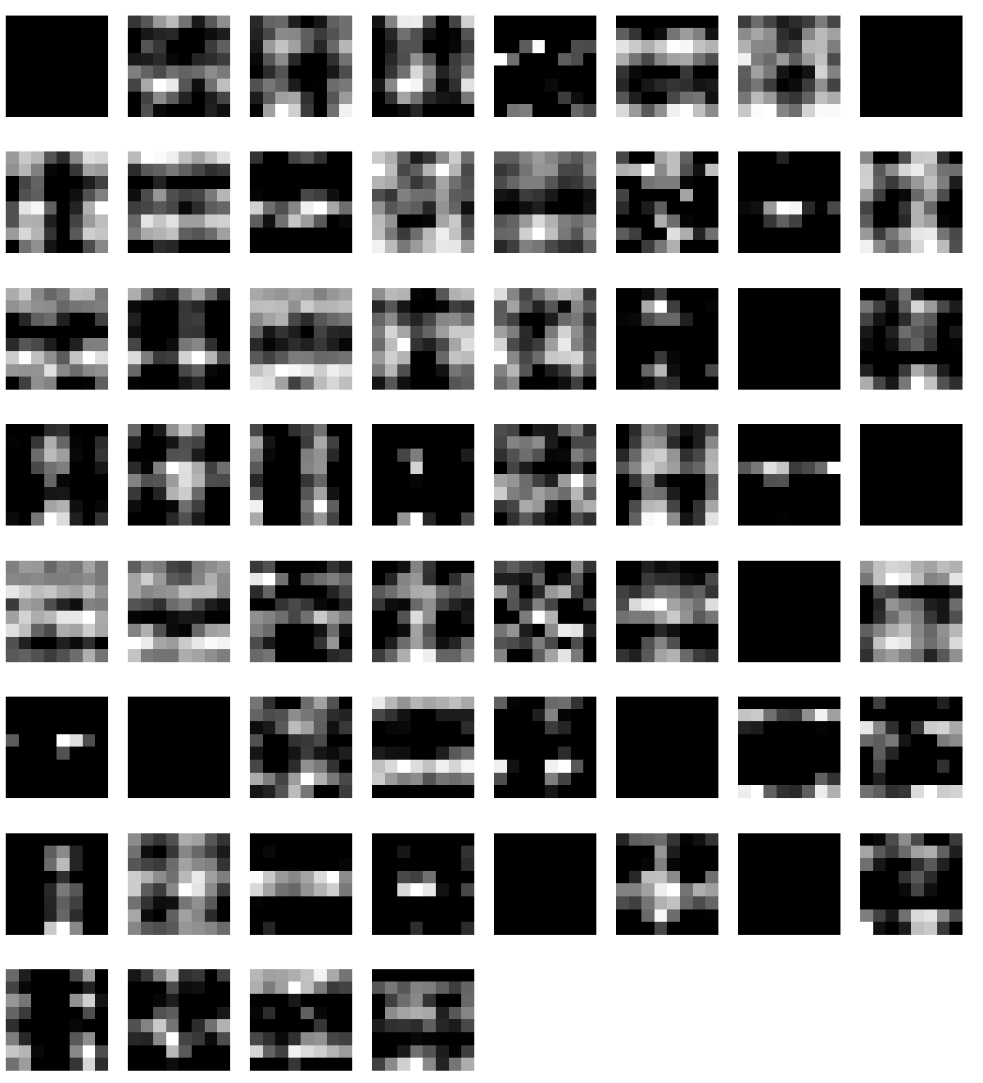
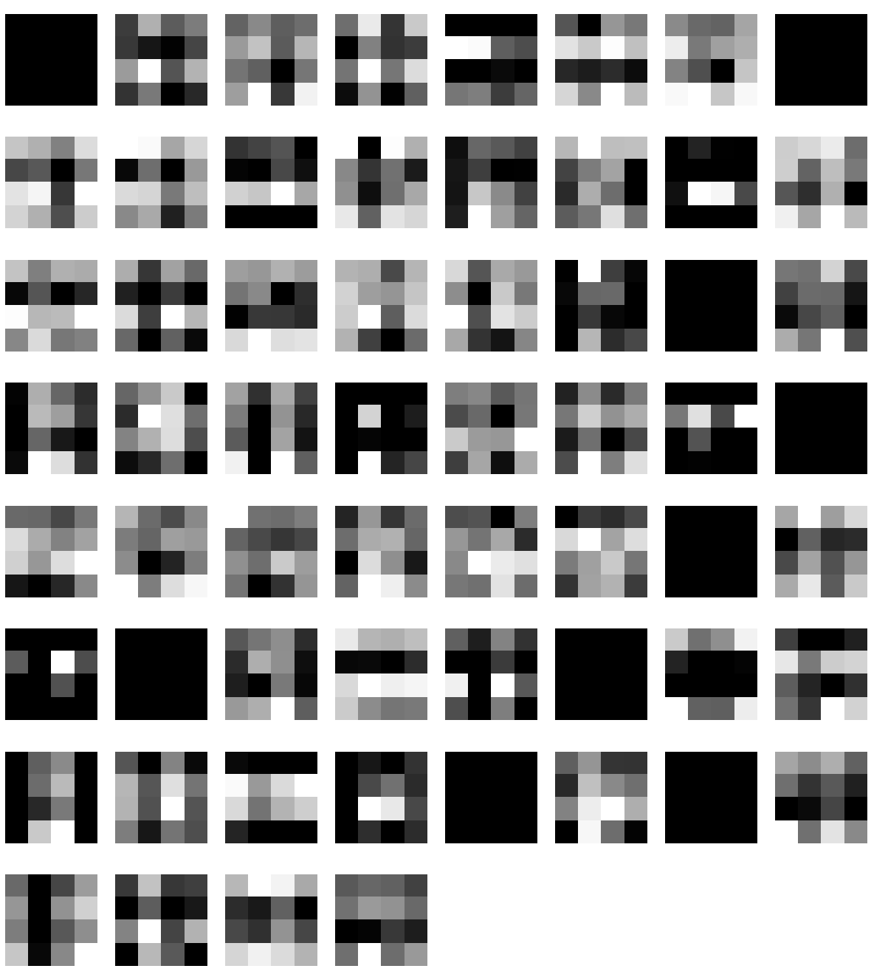
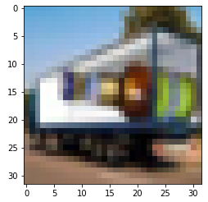
Reshape
Conv C1
Max Pool S1
Conv C2
Max Pool S2
Original

Slide 2
GRU
Vanilla RNN
LSTM
1x Dropout
Avg.T Accuracy: 0.9148
1x Dropout
Test Accuracy: 0.07286
1x Dropout
Test Accuracy: 0.8571
2x Dropout
Accuracy: 0.88
2 Layer RNN
1x Dropout
Test Accuracy: 0.82
2x Dropout
Avg. T Accuracy: 0.89386
Gradient Clipping
1x Dropout
Test Accuracy: 0.8229
2x Dropout
Test Accuracy: 0.8614

